Slide 2
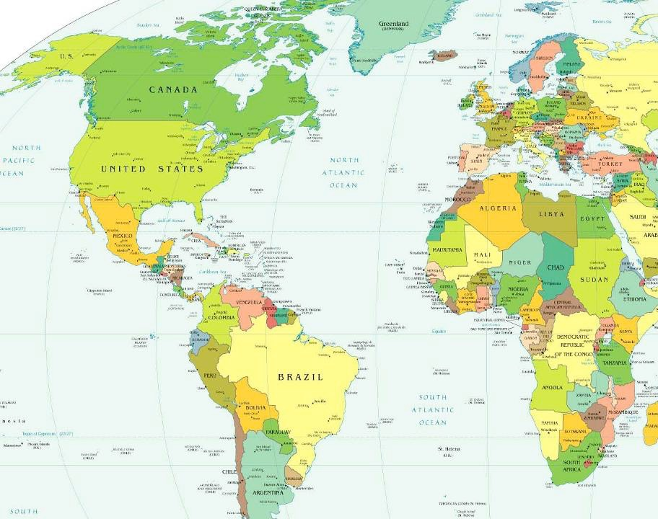
Zimbabwe
8400 Miles

Slide 3
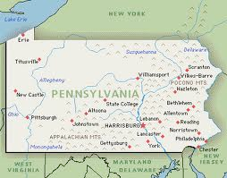
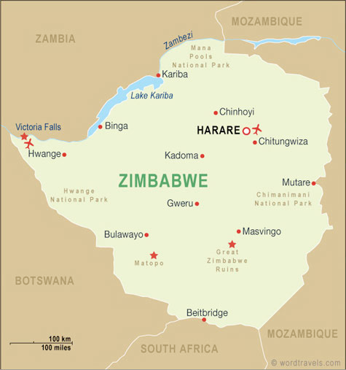
Nyadire
Pennsylvania and Zimbabwe
Zimbabwe is 3x the physical size
Population of both about the same - 13M
Metropolitan Harare - 3M people
Metropolitan Pittsburgh - 2.4M people

Slide 4
Zimbabwe 2017
Once called the “Breadbasket of Africa,” the country has a strong history of excellence in education, health care and agriculture
Now struggles with 85%+ unemployment and failing social services; 72% of people live in chronic poverty, surviving on $1.25/day
Zimbabwe government – Robert Mugabe, 93, president for the past 34 years – declared a “State of National Emergency” in 2016; UN implementing a “Humanitarian Response Plan”
Amid these struggles, TNC continues to build relationships and provide life-saving, critical aid and services, thanks to its many donors and partnerships … but we can do even more!
Should International Mission be a priority for our churches??

Slide 5
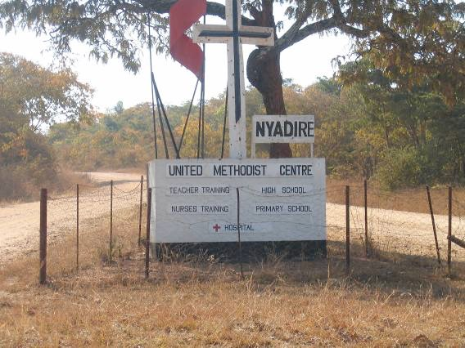
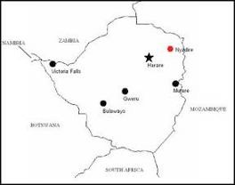
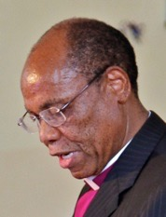
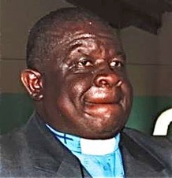
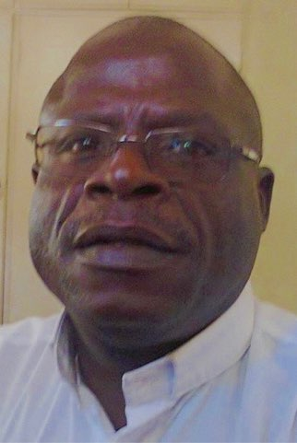
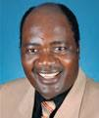
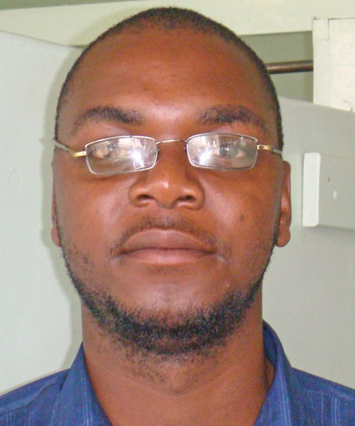
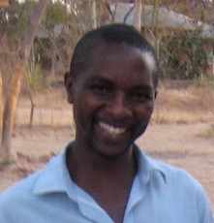
Nyadire United Methodist Mission
College Campus Like ~ Resident Houses ~ 4500 acres ~ Remote Rural Area ~ Frequently no running water or electricity ~ Depended upon by thousands ~ Owned & Operated by the United Methodist Church
150 Bed Hospital
6 Remote Clinics
1200 Student School with boarders
School of Nursing
Teachers College
Home of Hope Orphanage
Farm
Church
Nyadire
Zimbabwe
Bishop E. Nhiwatiwa
DS Rev E. Mutasa
Rev L. Mukundu
Rev F. Matonga
Dr. L. Tanyanyiwa
Emmanual Chimba

Slide 6
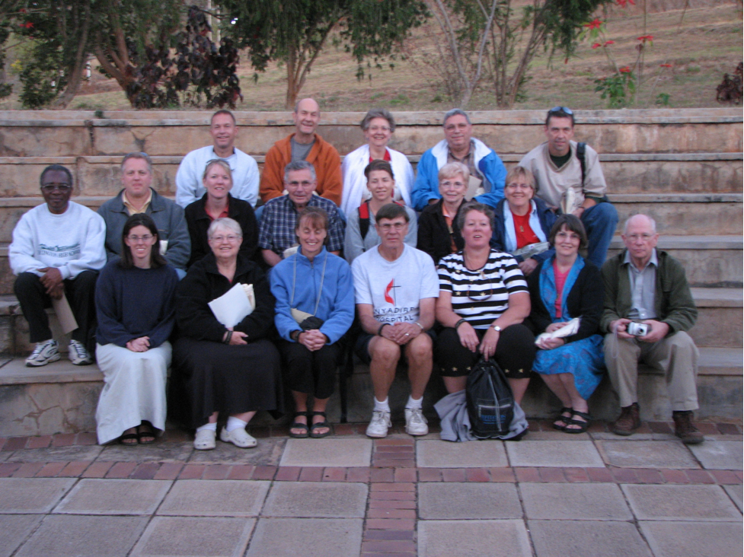
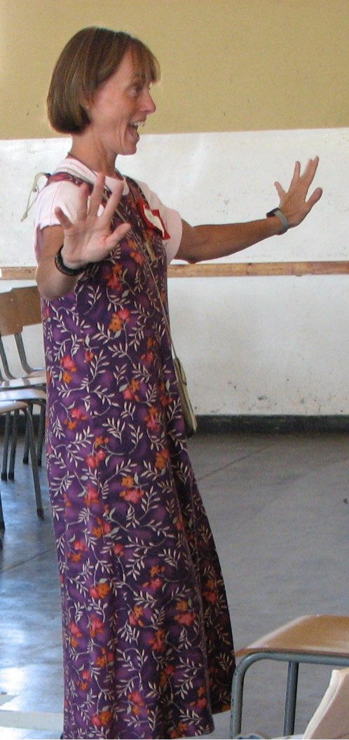
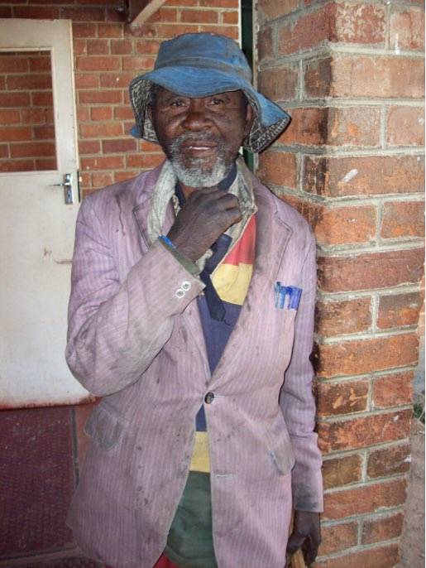
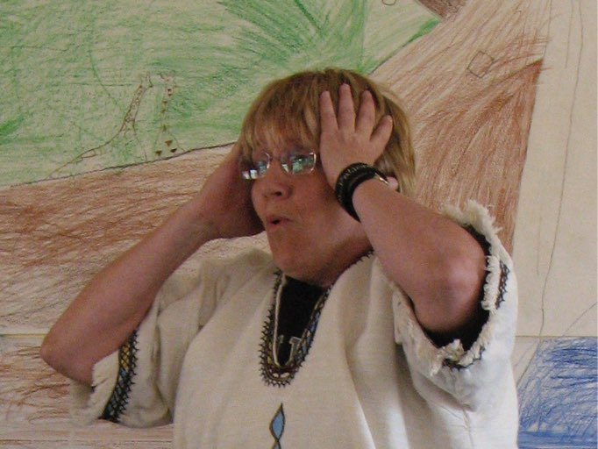
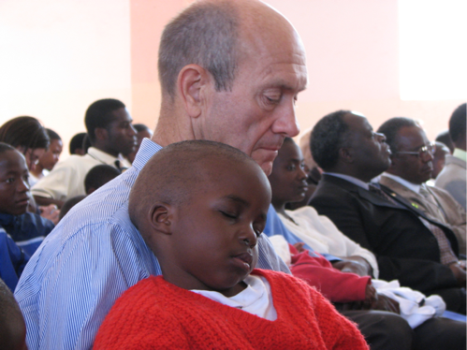
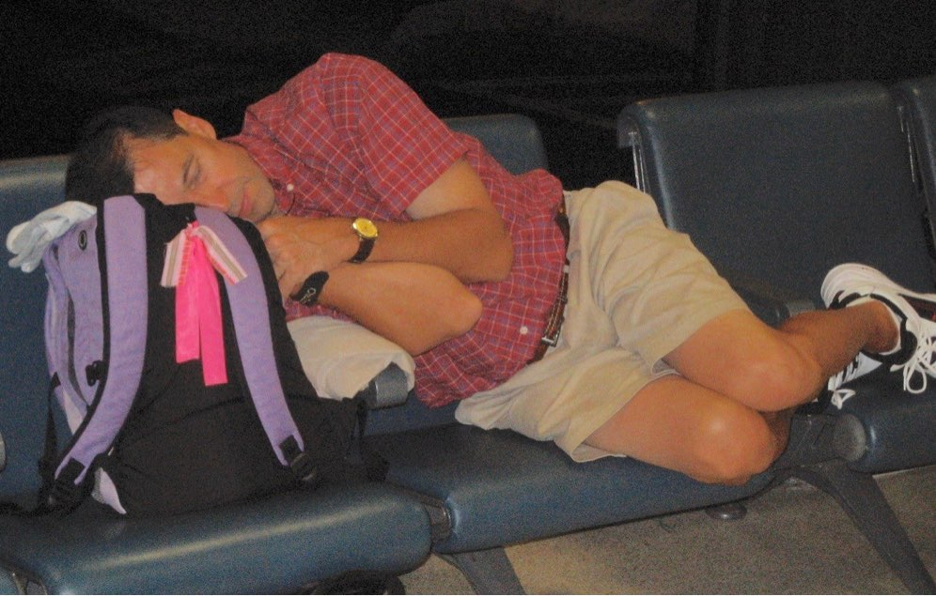
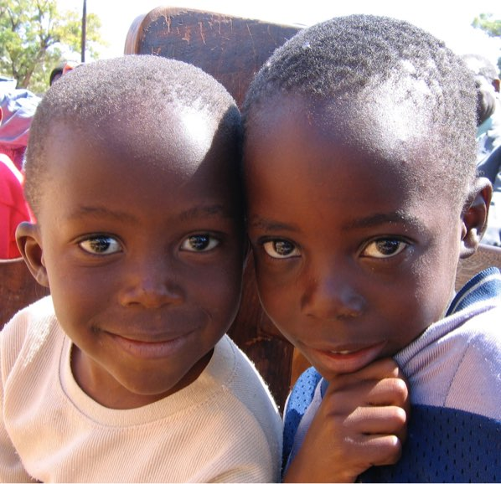
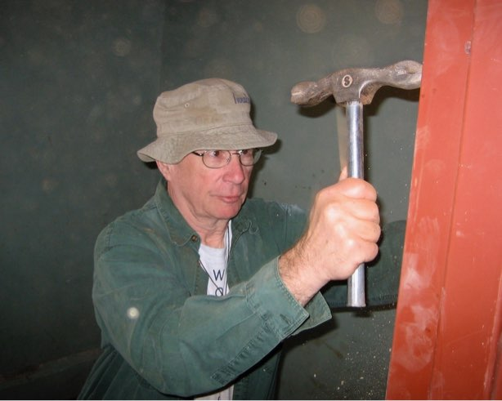
The Team Trip
2006

Slide 7
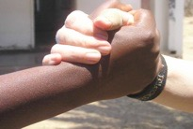
Operating Principles
10+ Years of Success
100% Volunteer
Build Long Term Committed Relationships; Educate each other and learn how to truly help.
Enable Connections - Person to Person. Church to Church. School to School. Hospital to Hospital.
Enable Nyadire to help the people of Zimbabwe, while enriching spiritual lives in Western Pa. Partnership
Focus on Nyadire and support Nyadire’s priorities, not our ideas. Nyadire & the Zimbabwe United Methodist Church lead; TNC enables
Provide Feedback - supporters will see what happens

Slide 8
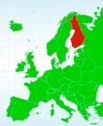
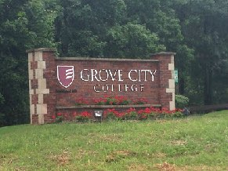
Support Network
Churches - CUMC, Mt. Leb., St. Paul’s, Dutilh UMC, 1st Bethel, Liberty, Baldwin Community
The Methodist Church of Finland
UMCOR – GBGM
Schools - Bethel Park, Char Valley, Mt. Lebanon, USC, Seneca Valley, Pitt, others
Carnegie Mellon University - Engineers Without Borders
Grove City College
Brother’s Brother Fdn.; Global Links Fdn.
Jefferson Hospital, Allegheny General
Businesses/Non-Profits - Tri-States Medical Supply, Half Price Books, Free Ride Bicycles, Rotary, Gardner Moving, Computer Reach, Mission Vision, many others
Craft Groups - Creative Hands, Linus Group, Hands & Hearts for Mission
United Methodist Church of Finland

Slide 9
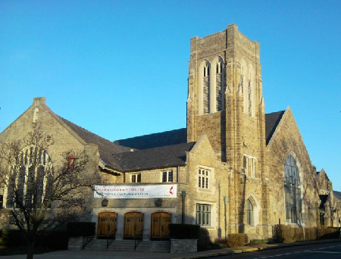
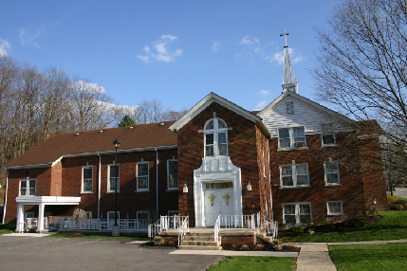
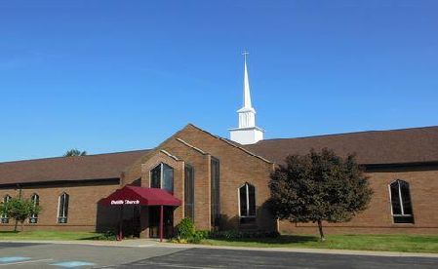
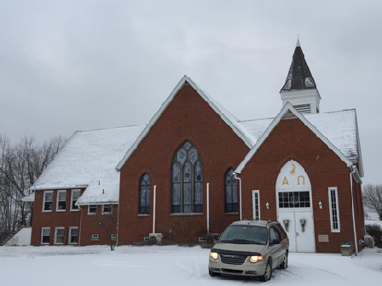
How do we
work together ??
Christ UMC
Bethel Park
St Paul’s UMC
Allison Park
Mt Lebanon UMC
Mt Lebanon
First Bethel UMC
Bethel Park
Dutilh UMC
Warrendale
Baldwin Community
UMC - Castle Shannon
Liberty UMC
Washington

Slide 10
A
R
E
A
S
P
R
O
G
R
A
M
S

Slide 11
A
R
E
A
S
Health
Hospital/Doctors
Medicine Drugs
Ocean Containers
Clinic Rebuilds
Eyeglasses
Empowerment Pads
P
R
O
G
R
A
M
S

Slide 12
A
R
E
A
S
Health
Orphans
Hospital/Doctors
Medicine Drugs
Ocean Containers
Clinic Rebuilds
Eyeglasses
Empowerment Pads
P
R
O
G
R
A
M
S
Home of Hope
Home of Hope Outreach

Slide 13
A
R
E
A
S
Health
Orphans
Sustainability
Hospital/Doctors
Medicine Drugs
Ocean Containers
Clinic Rebuilds
Eyeglasses
Empowerment Pads
P
R
O
G
R
A
M
S
Seeds of Hope
Farm
Micro-Loans
Home of Hope
Home of Hope Outreach

Slide 14
A
R
E
A
S
Health
Orphans
Sustainability
Education
Hospital/Doctors
Medicine Drugs
Ocean Containers
Clinic Rebuilds
Eyeglasses
Empowerment Pads
O-Level Textbooks & Exams
CMU EWB program
Grove City College Connection
Hearing Impaired
Scholarships
P
R
O
G
R
A
M
S
Seeds of Hope
Farm
Micro-Loans
Home of Hope
Home of Hope Outreach

Slide 15
Each program has a Leader in Zimbabwe
& a Co-Leader in Pittsburgh
A
R
E
A
S
Health
Orphans
Sustainability
Education
Relationships
Hospital/Doctors
Medicine Drugs
Ocean Containers
Clinic Rebuilds
Eyeglasses
Empowerment Pads
O-Level Textbooks & Exams
CMU EWB program
Grove City College Connection
Hearing Impaired
Scholarships
VIM Teams to Nyadire
Pastor Partnership & Church Development
Christmas Connection
Rotary
P
R
O
G
R
A
M
S
Seeds of Hope
Farm
Micro-Loans
Home of Hope
Home of Hope Outreach

Slide 16
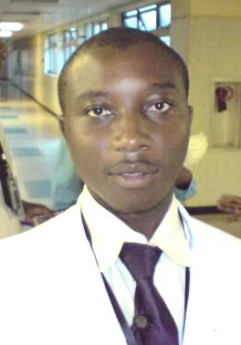
Programs
Health
1. Medical / Doctor Support
Two Doctors now at Nyadire Hospital:
Medical Superintendent - Dr. Larry Tanyanyiwa
Dr. Ronald Nyabereka
2. Medicine Supply
Drugs ordered as requested by Nyadire
Consumption tracked
Order placed with PCD company in Harare
Program Co-Leaders - Irina Sheyko & Wilson Nhamoinesu

Slide 17
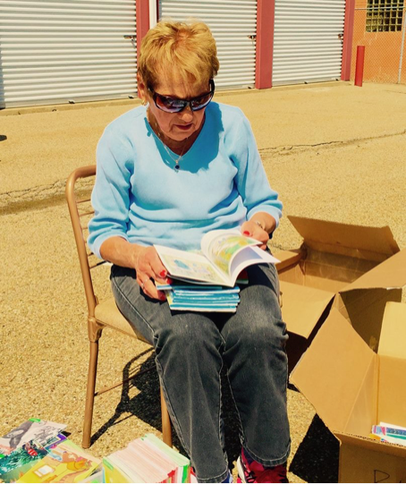
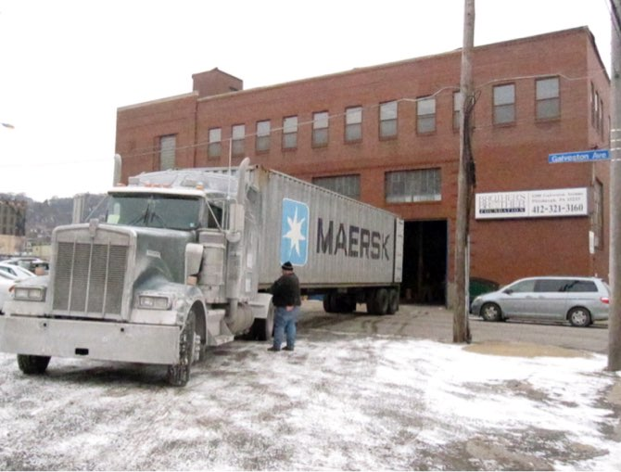
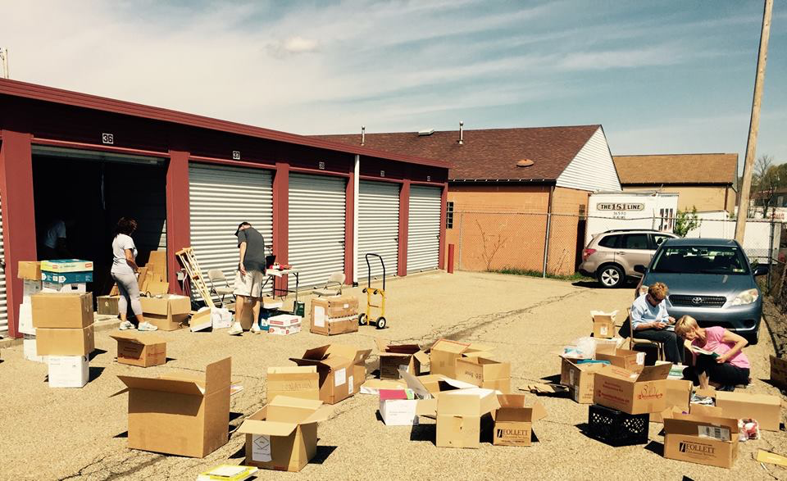
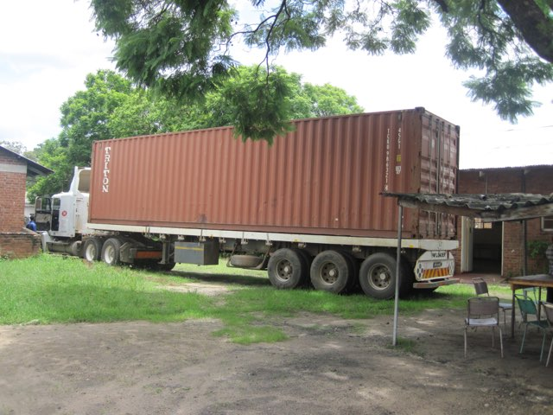
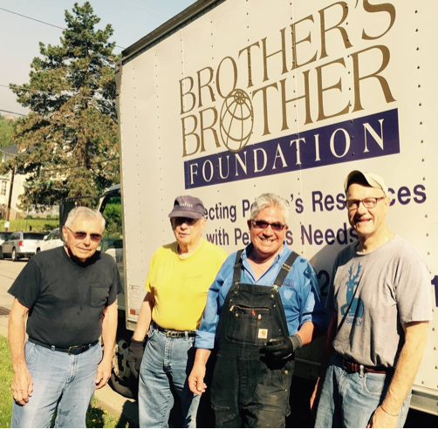
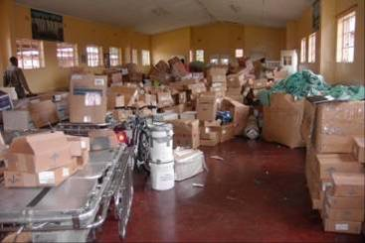
Programs
Health
Container Shipments
As of 2016 ~
15 containers sent
$150,000 shipping fees
Tens of Thousands of Items

Slide 18
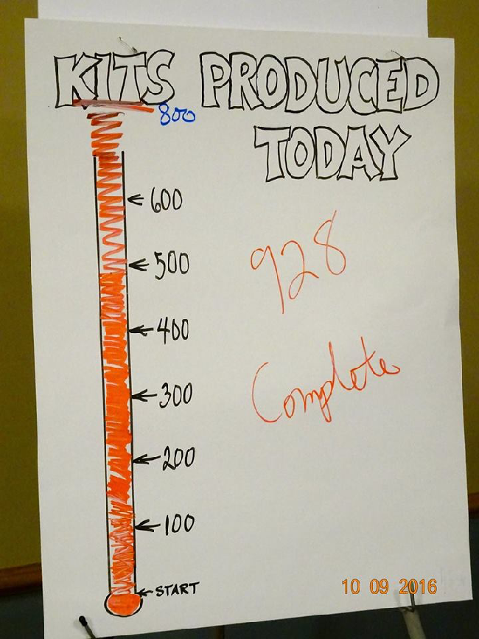
Programs
Empowerment Pad Sewing Party
Mt. Lebanon UMC - Oct 2016
Health

Slide 19
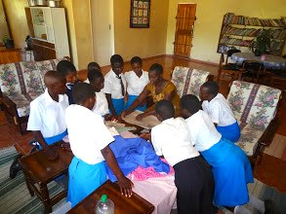
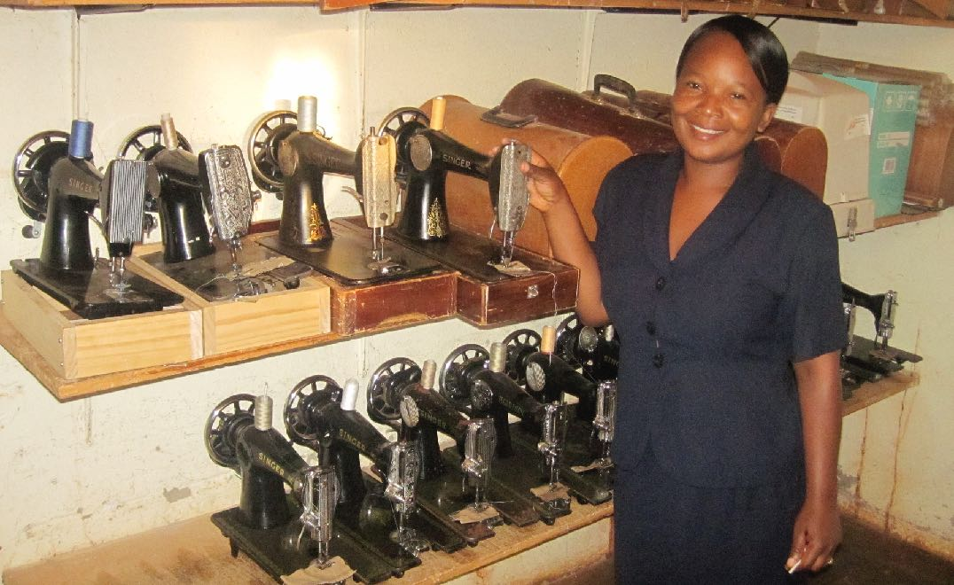
Programs
Girls Empowerment Pads

Slide 20
Nyadire United
Methodist Hospital
& the
6 Rural Health Clinics
1. Dendera
2. Nyahuku
3. Chikwizo
4. Chindenga
5. Dindi
6. Mashambanhaka
Programs
5
6
4
1
2
Health
Nyadire
3
Rural Clinic Renovation

Slide 21
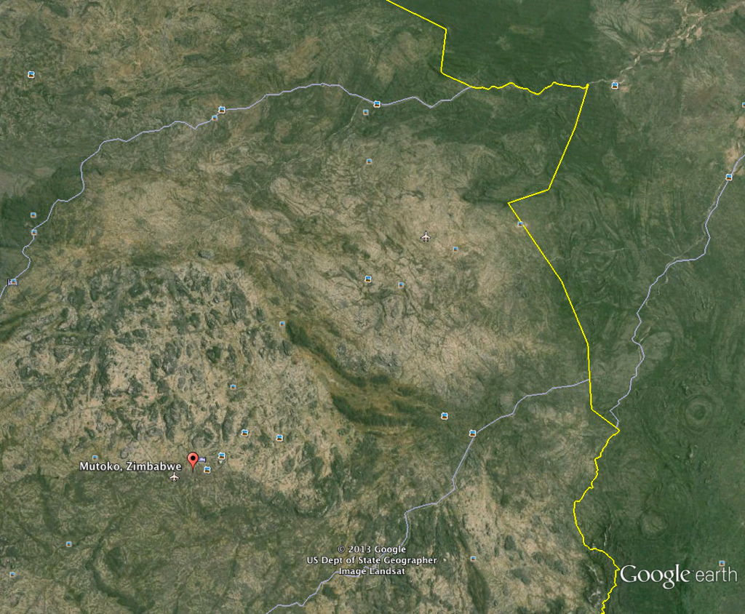
10,000 people die every year in this region from Malaria!
Nyahuku
Dindi
Dendera
Mozambique
Border
Chikwizo
Chindenngu
90 miles
Mashambanhaka
Nyadire United
Methodist Mission
Zimbabwe
Mashonaland East

Slide 22
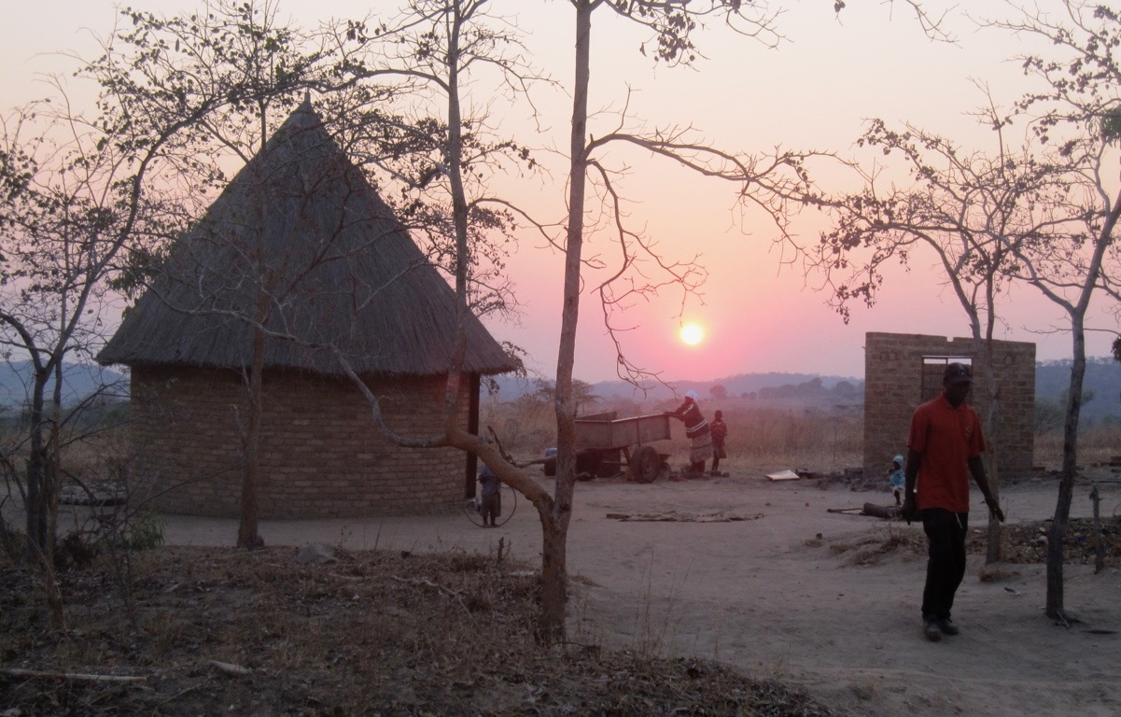
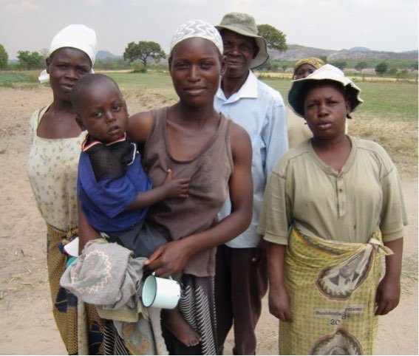
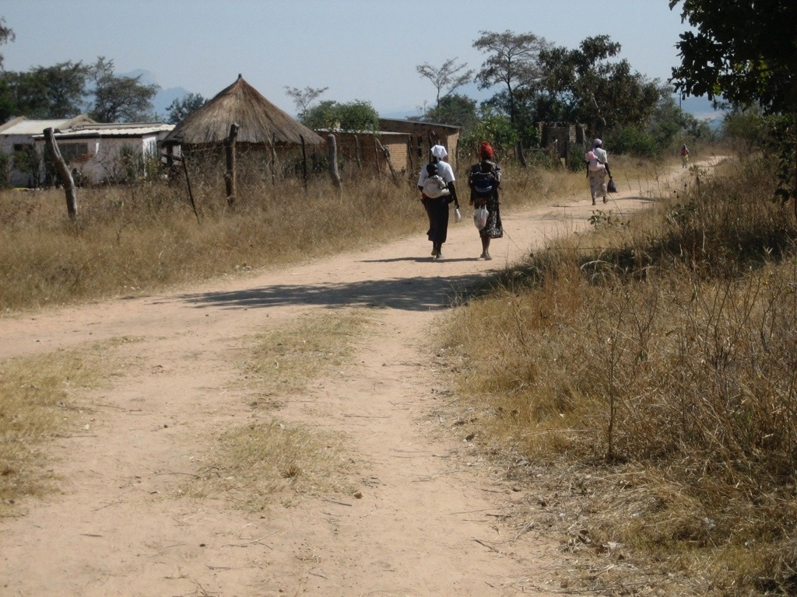
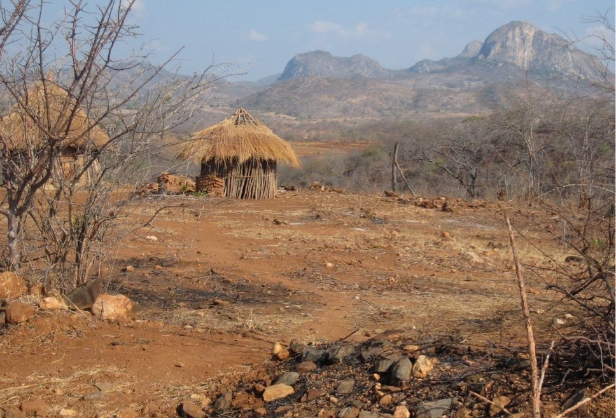
The Rural People of Mashonaland East

Slide 23
Mashoneland East -- 700,000 people
Each Year:
400 Mothers die during the birth of their children
1400 children under age 5 die because of limited access to care
1600 people die of Diabetes related illness
2100 people die of HIV
10,000 die from Malaria

Slide 24
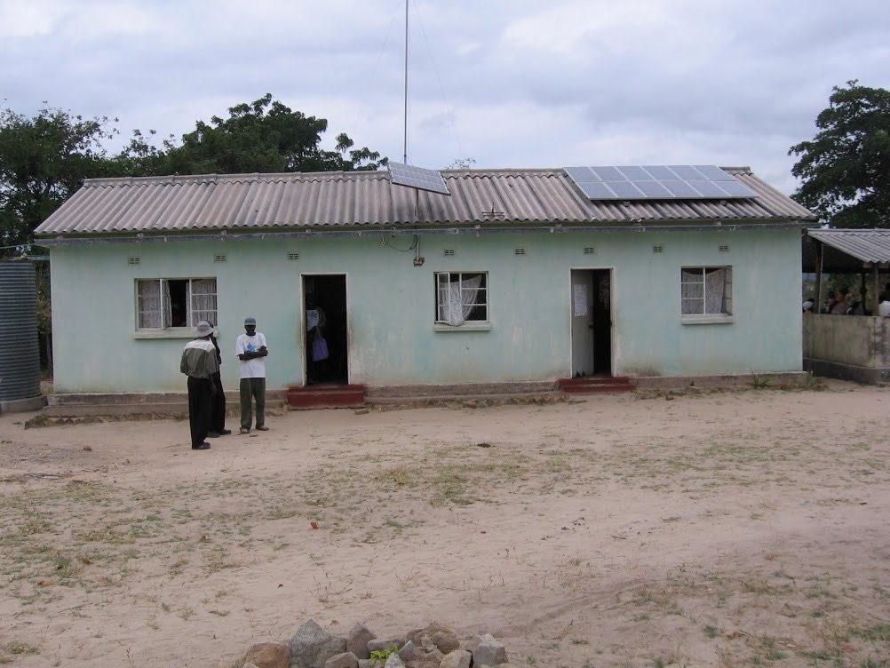
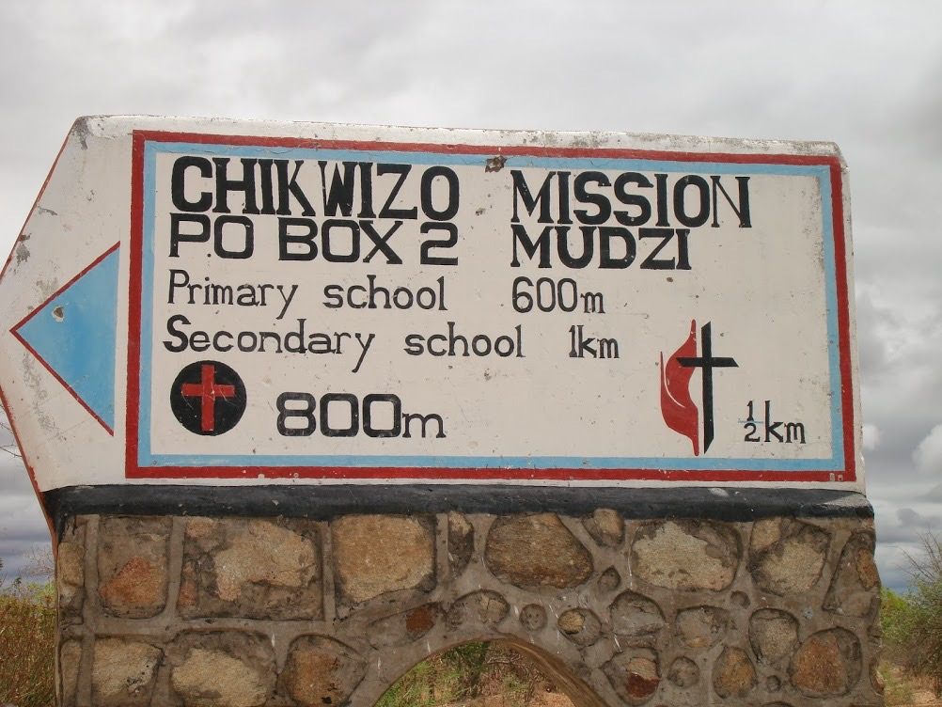
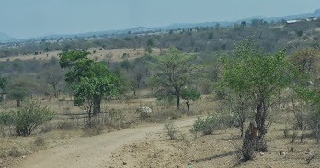
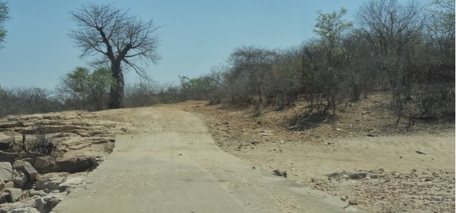
Chikwizo - the starting point
The Road to Chikwizo

Slide 25
Chikwizo - the objective
Serves a rural population of > 8000; 1500 visits/month
Maternity; HIV management; Malaria; Immunizations; Infectious disease; Tuberculosis, First Aid
Ministry of Health Design ; Staffing is 2 Nurses, 2 Nurse Aids; 1 Groundsman

Slide 26
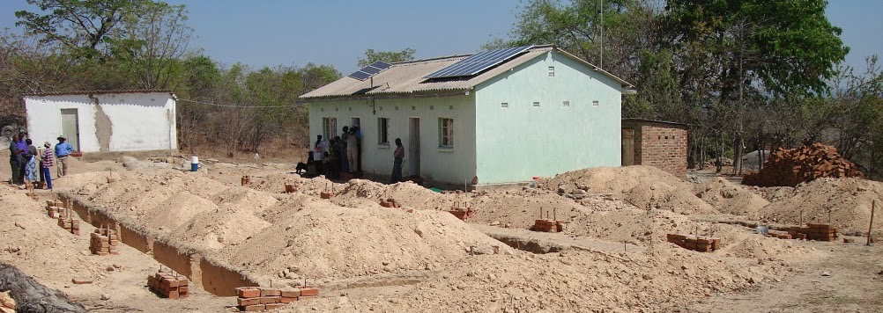
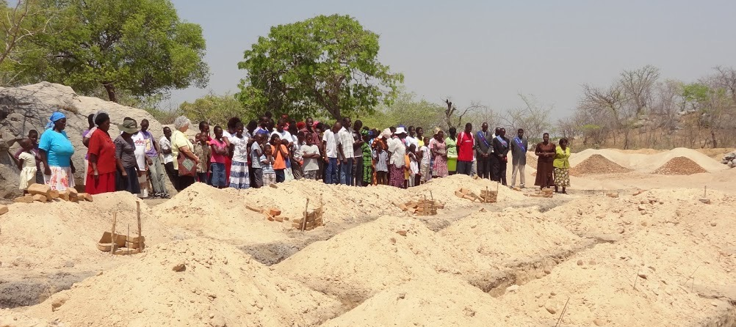
Getting Started & Building with Prayers
Oct 2013

Slide 27
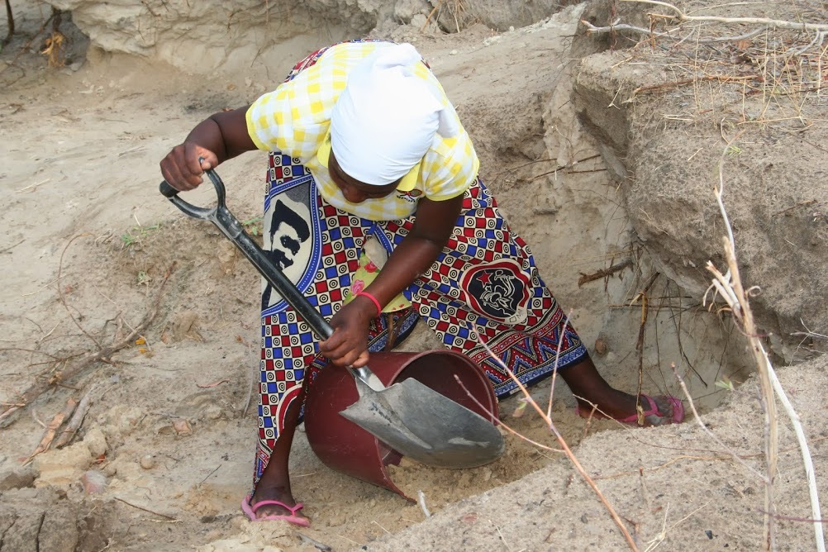
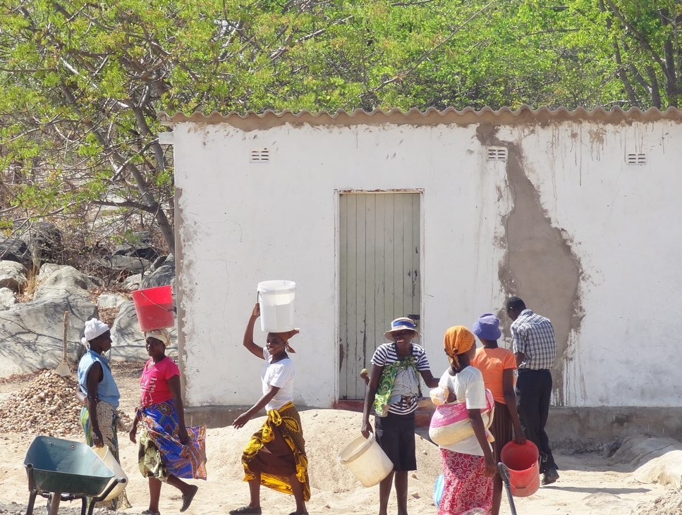
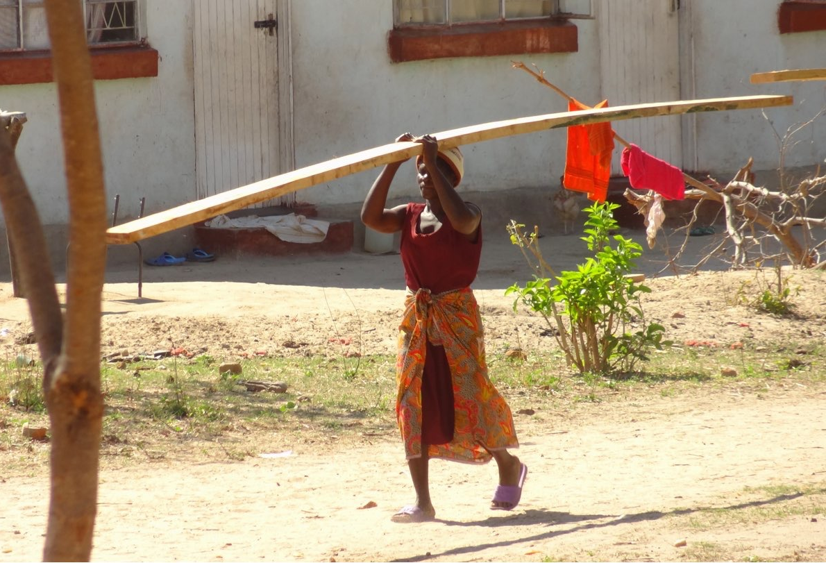

Slide 28
Baby
Bricks, Bricks, and MORE BRICKS!
Each community makes all the bricks
required for construction. Sand & gravel are hand
carried from a riverbed. Bricks are made 3 at a time
and baked in the sun.

Slide 29
Throughout Construction ~
Continued Immunizations & Medical Care

Slide 31
Waiting Mother’s Lodging

Slide 32
Housing
Clinic Wards
Water !
Entrance Gate

Slide 33
On to #2 - Nyahuku !

Slide 34
#2 - NYAHUKU
$309,000
Groundbreaking - March 2015

Slide 39
Sand Delivery
The First Borehole….

Slide 40
Nyahuku Clinic
October 2015

Slide 41
#3
Dendera Clinic
to be complete
July, 2017

Slide 42
Programs
Health
Vision
As of 2016 ~
800 people with eyeglasses
“Things suddenly look so Bright!”
“I can read my Bible now”

Slide 43
“Bandera” - Age 83
380% Improved Vision
“Grace” - Age 81
2000% Improved Vision
“Makarutsa” - Age 8
367% Improved Vision
“Zunze” - Age 97
217% Improved Vision
Don Ziegler with the Vision Team in 2016

Slide 44
Programs
Orphans
Home of Hope
17 children live together as a family (2016)
Sponsorships make it possible!
Sponsors - a very personal, enabling, and important connection for each child
HOH Administrator
Emmanuel Chiimba
&
wife Catherine
“Tatenda”

Slide 45
Dorcus & Dorothy
The Kids
Tanatswa
Nyasha

Slide 46
The New Home of Hope
2 wings each with 5 BR’s
2 mothers & 8-12 children/wing
MUCH PROPERTY
for Farming!
Current Home of Hope
17 Children
Move should happen by summer 2017

Slide 47
Agricultural Development -
Could the HOH be self-supporting??
The Future ???

Slide 48
Programs
Orphans
Home of Hope Outreach
400 - 450 kids kept in School
Sponsors provide annual school fees
& a Backpack
Nyamhara Secondary School

Slide 49
Bicycles to Nyamhara School from
Mt. Leb UMC Network Class

Slide 50
Programs
Sustainability
as of 2016 ~
25,000 packets of seeds provided
Seeds = Food

Slide 51
Programs
Sustainability
Micro-Loan Program
Date | 1/7/17
 |  |  |  |  |  | Total
Date | Name | Maturity | Project | Principal | Fee | Loan
12/10/10 | Bandira Letitsia |  | Poultry | $ 350 | $ - | $ 350
1/10/10 | Mukudoka Simon |  | Beef | $ 300 | $ - | $ 300
26/1/11 | Mukoyi Canaan | 1/2/12 | Fish | $ 400 | $ 40 | $ 440
26/6/11 | Mutasa Violet | 1/2/12 | Poultry | $ 250 | $ 25 | $ 275
31/12/11 | Arichara Esinath | 1/7/12 | Clothing | $ 400 | $ 40 | $ 440
31/12/11 | Muskwe Loveness | 1/7/12 | Clothing | $ 300 | $ 30 | $ 330
31/12/11 | Marovatsanga Memo | 1/7/12 | Poultry | $ 400 | $ 40 | $ 440
14/6/12 | Mudiwa Abigail | 1/3/13 | Clothing | $ 500 | $ 50 | $ 550
14/6/12 | Nyabote Elina | 1/3/13 | Clothing | $ 500 | $ 50 | $ 550
14/6/12 | Musaririr James | 1/3/13 | Poultry | $ 500 | $ 50 | $ 550
14/6/12 | Mashoko Charles | 1/4/13 | Poultry | $ 500 | $ 50 | $ 550
14/6/12 | Chidhakwa Artwell | 1/3/13 | Beef | $ 500 | $ 50 | $ 550
28/4/13 | Kapfunde Abigail | 1/10/13 | Poultry | $ 500 | $ 50 | $ 550
28/4/13 | Bandira Letitsia | 1/10/13 | Layers | $ 500 | $ 50 | $ 550
28/4/13 | Chipuriro Irene | 1/10/13 | Beef | $ 500 | $ 50 | $ 550
28/4/13 | Chikowo Fidelis | 1/10/13 | Beef | $ 500 | $ 50 | $ 550
28/4/13 | Murimba Tendai | 1/10/13 | Beans | $ 500 | $ 50 | $ 550
28/4/13 | Mutasa Violet | 1/10/13 | Catering | $ 500 | $ 50 | $ 550
1/8/13 | Dhliwayo Jonathan | 1/3/14 | Beef | $ 500 | $ 50 | $ 550
1/8/13 | Mutasa Violet | 1/3/14 | Catering | $ 1,000 | $ 100 | $ 1,100
1/12/13 | Mthandwa | 1/7/14 | Hatchery | $ 500 | $ 50 | $ 550
1/12/13 | Kapasura Thomas | 1/7/14 | Transport | $ 500 | $ 50 | $ 550
1/12/13 | Kanyere | 1/7/14 | Irrigation | $ 600 | $ 60 | $ 660
 |  |  |  | $ 11,000 | $ 1,035 | $ 12,035
25 Loans
Program being evaluated & revised

Slide 52
Programs
Education
O-Level Textbooks / Exams
Textbooks req’d to prepare for O-Level Exams
Books provided in exchange for completed service work.
O-Level Exams are mandatory for a student to continue with education.
Typical cost/student to take exams is $100
As of 2016 ~
Over the last 6 years,
670 books purchased & distributed to 4 schools.
Total Cost - $14,750
English, Agriculture, Home Economics, Accounting

Slide 54
Service Work - 1 hour for each dollar spent on
the O-Level Exam Preparation Textbook

Slide 55
Funding the O-Level Exams !
Super Chicken Ticket Sale Lady — Phil Himmler

Slide 56
EWB – Zimbabwe
Programs
Education

Slide 57
Lighting for the Nyadire Campus

Slide 58
Programs
GCC Professors / student - at Nyadire in Jan 2017
Student team scheduled for Jan 2018
Service Programs
Internships
Ongoing Relationship
Education

Slide 59
Programs
Education

Slide 61
Programs
Relationships
As of 2016 ~
39 Trips
98 Individuals
198 person trips
13,000 pounds of donations
July 2006
July 2016
Carry-Over

Slide 62
Programs
Packing Party for the July 2017 team of 12
2017 - Scheduled TNC Vim Teams
Don Ziegler there now
Team of 12 departs July 20
Team of 8 (EWB) departs Aug 13
Family team departs Dec 26
GCC student team departs Jan 2, 2018

Slide 63
Programs
Relationships
Pastor Partnership
29 Pastors in the Mutoko - Mudzi District
“I have been richly rewarded by my involvement as I grew in the knowledge of the people and culture.”

Slide 64
Programs
Relationships
Christmas Connection
500 cards sent to Nyadire employees
Each signed & individually addressed

Slide 65
Programs
Relationships
District Grants
Global Grants - minimum $30,000

Slide 66
How do we
work together ??
Christ UMC
Bethel Park
St Paul’s UMC
Allison Park
Mt Lebanon UMC
Mt Lebanon
Dutilh UMC
Warrendale
First Bethel UMC
Bethel Park
Liberty UMC
Washington
Baldwin Community UMC
Castle Shannon

Slide 67
TNC Opportunities
A More Formal Relationship
Select TNC as your church's international mission priority & focus
Provide a line item in the church's general budget for TNC
Include TNC description on church website and link to TNC’s website
Publicize TNC "Volunteers in Mission" trips to Nyadire and encourage church members to attend
Provide an online giving option on your website for donations to TNC
Include a portion of any capital campaign for mission, including TNC
Where appropriate, make distributions from Trusts, or church endowments to a TNC program
Greater Communication
Appoint an advocate to keep your congregation updated on TNC, and to keep TNC updated on your church
Schedule programs throughout the year by TNC to a variety of groups -Sunday Schools, Women's Circles, the Congregation, etc.
Host multi-week educational programs with TNC speakers, or resources from the Africana Studies Program at Pitt
Provide opportunities for us to tell the congregation TNC's story and ask for financial support
Publish regular articles supplied by TNC, in the church newsletter
Host programs once or twice/year where a member from a "Volunteers in Mission" team returning from Nyadire would provide a summary of the trip

Slide 68
TNC Opportunities
Leadership/Ownership
Take "ownership" of leading a TNC program or area
Select a pastor or key staff member and raise funds as a church to send that person to Nyadire with a "Volunteers in Mission" team
Integrate TNC into the various church ministries (examples: choir sings Shona songs; utilize videos of Nyadire choirs; CUMC developed a coloring book for their Children's Ministries showing daily life of a Nyadire child)
Additional Dedicated Fundraising
Select TNC as a recipient of Holiday Offerings - Thanksgiving, Christmas, Easter
Include TNC options on the Christmas "Angel Tree“
Sponsor an ocean container shipment to Nyadire, as a church
Purchase Hippo Water Rollers
Provide regular "recruiting" opportunities for TNC to solicit sponsorships from the congregation for the Home of Hope and Home of Hope Outreach orphans, Zimbabwe pastors, the hearing impaired
Include TNC craft sales at church events
Include Sarris Candy for sale in all church offices, with proceeds to TNC
Encourage Sunday School Classes, Choirs, Men's Groups, UMW circles, etc to sponsor a number of orphaned children or another specific TNC cause

Slide 69
TNC “FriendRaiser” Event
Thursday, Sept 21
4:00 - 8:00pm
Two Venues:
Calvary UMC
& Brother’s Brother Foundation
Calvary United Methodist Church
Everyone attends both venues
Location on North Side - close together
Heavy Appetizers
$25 ticket
Please come and learn about TNC!
Brother’s Brother Foundation

Slide 70
TNC: 10 Years of Success, But We Can Do More!
"Never doubt that a small group of thoughtful, committed citizens can change the world;
indeed, it's the only thing that ever has."
~ Margaret Mead
"Do not be daunted by the enormity of the world's grief.
Do justly, now. Love mercy, now. Walk humbly, now.
You are not obligated to complete the work, but neither are you free to abandon it."
~ The Talmud

Slide 72
“Everyday is a New Day — Everyday is a Gift from God “

